Slide 1
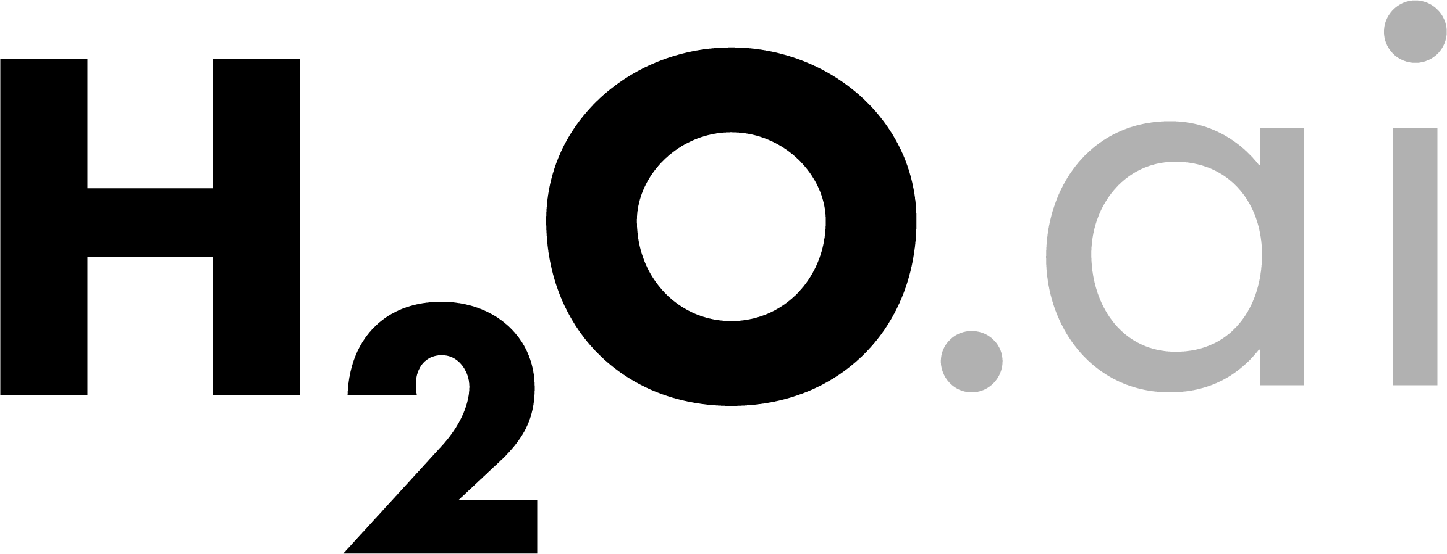
About Me
Civil (Water) Engineer
2010 – 2015
Consultant (UK)
Utilities
Asset Management
Constrained Optimization
EngD (Industrial PhD) (UK)
Infrastructure Design Optimization
Machine Learning + Water Engineering
Discovered H₂O in 2014
Data Scientist
2015 – 2016
Virgin Media (UK)
Domino Data Lab (Silicon Valley)
2016 – Present
H₂O.ai (Silicon Valley)
How?
bit.ly/joe_kaggle_story

Slide 2
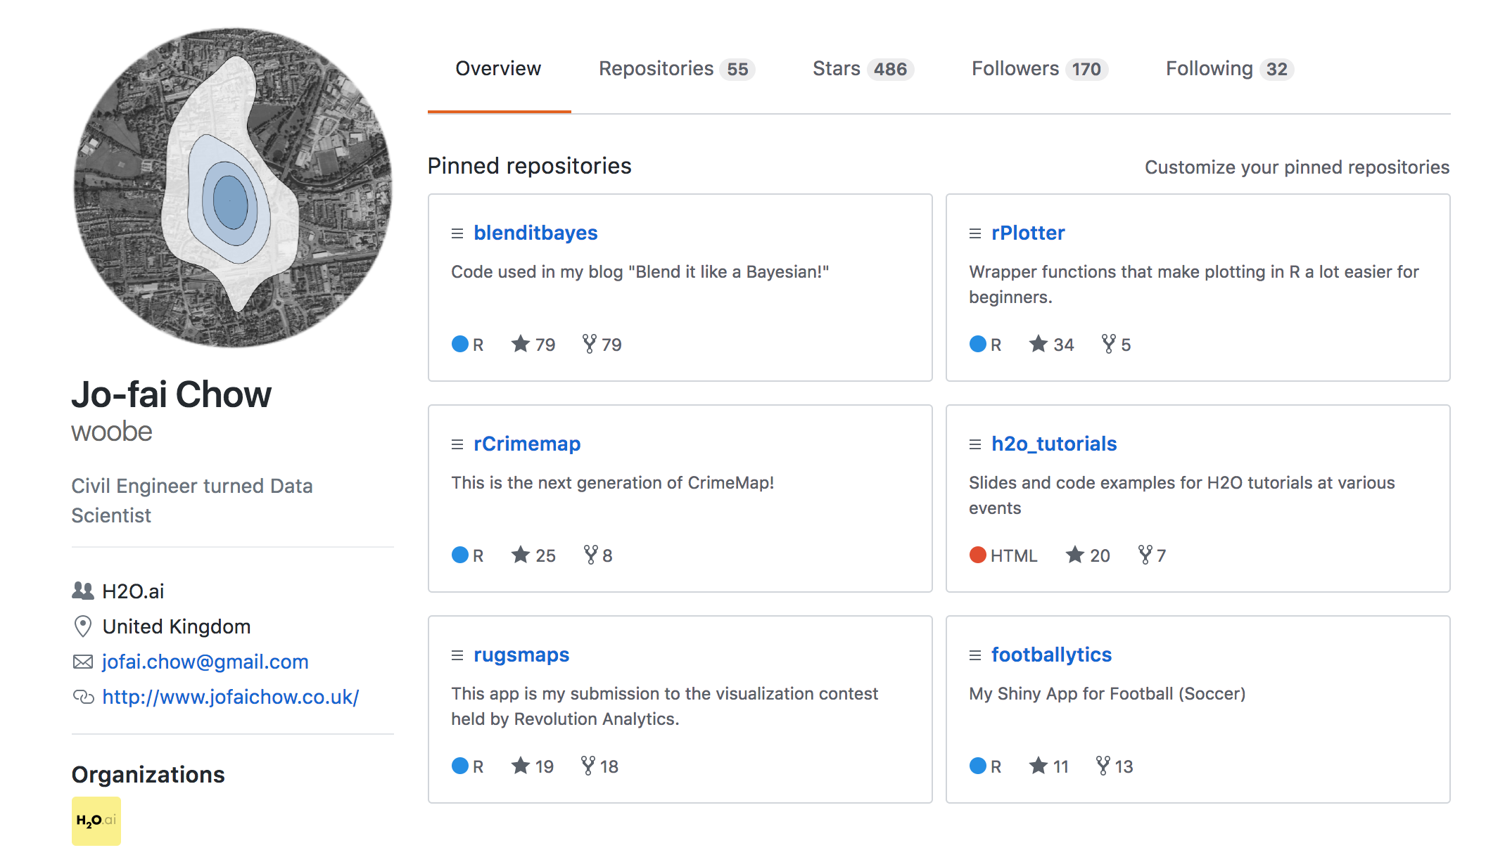
About Me – I ❤️ R

Slide 3
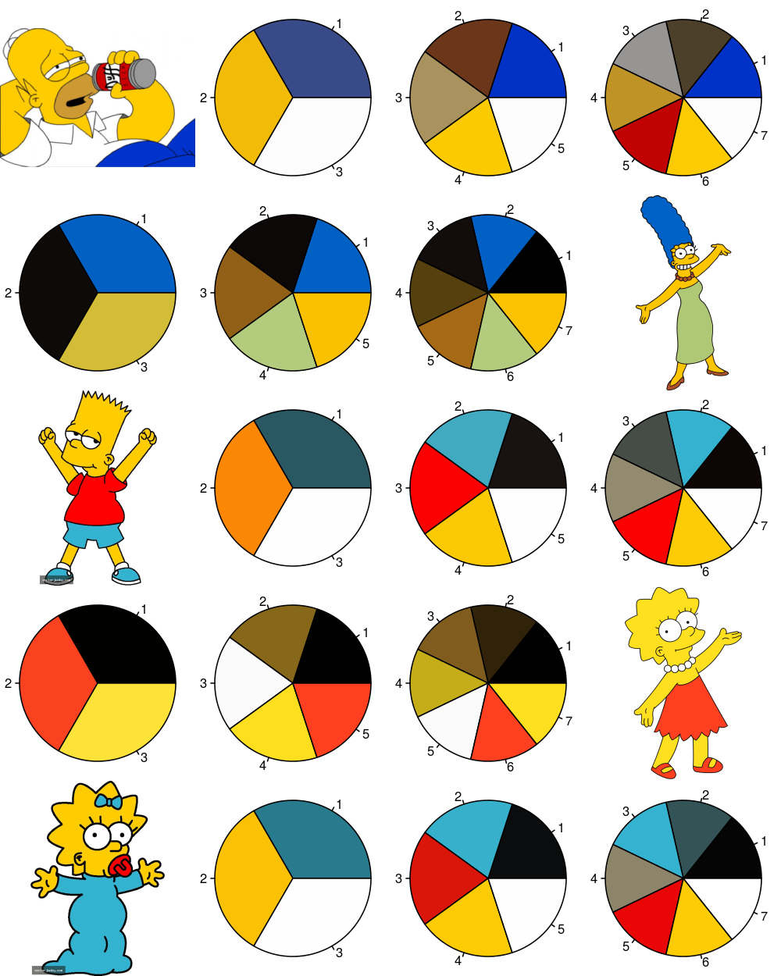
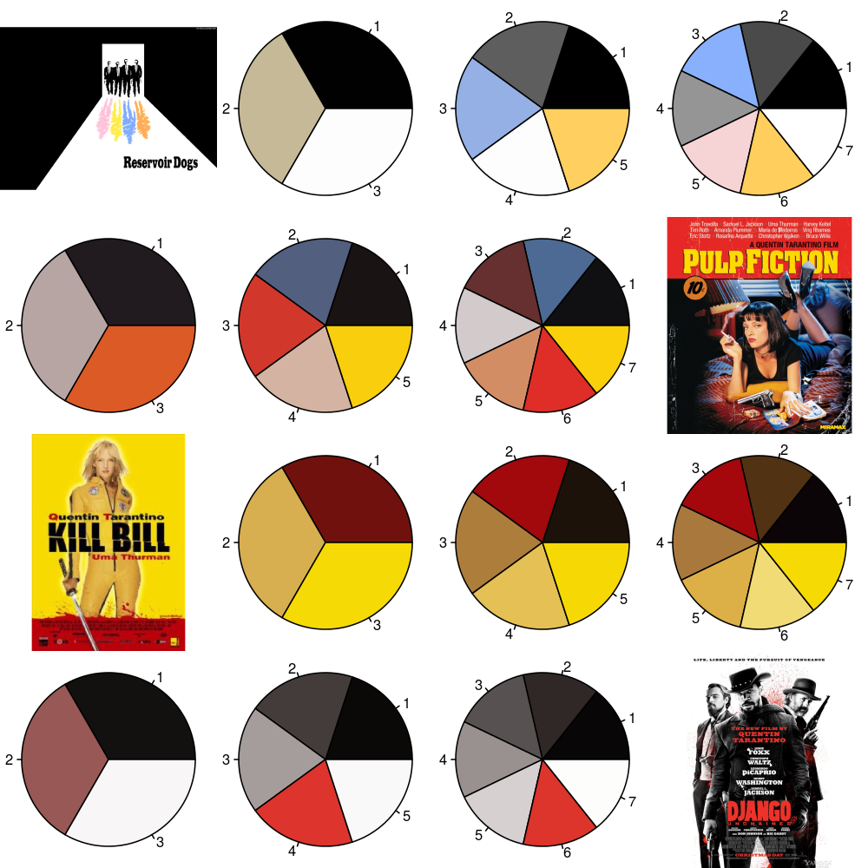
About Me – I ❤️ Colours
Developing R Packages for Fun
rPlotter (2014)

Slide 4
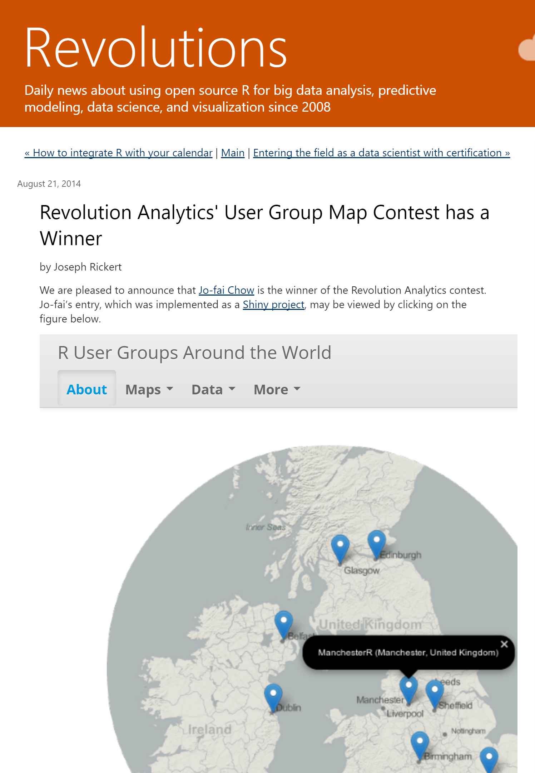
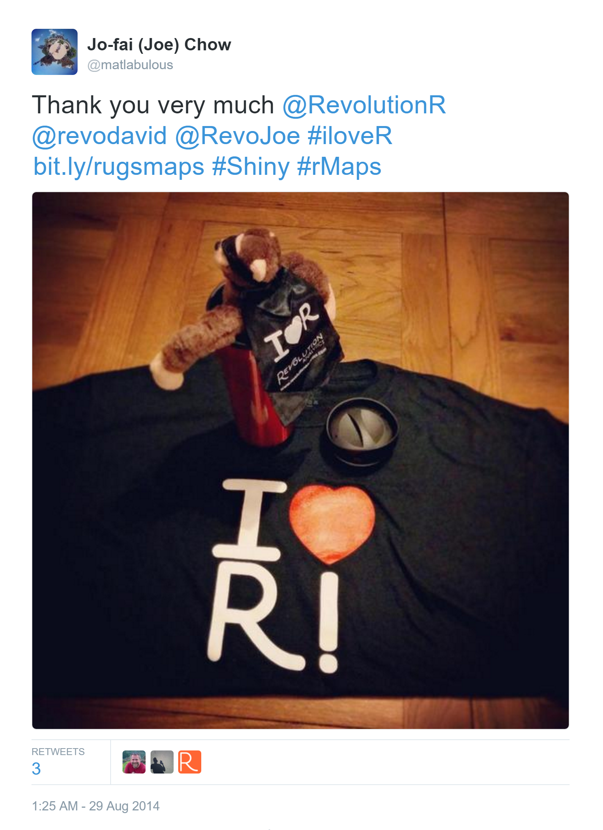
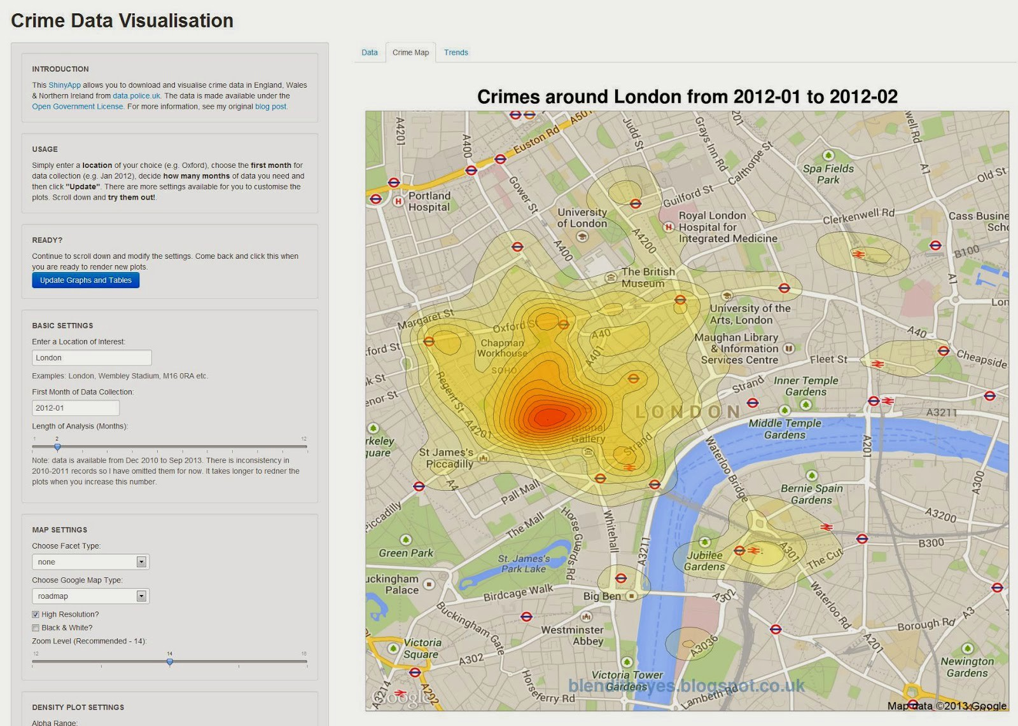
About Me – I ❤️ DataViz
My First Data Viz & Shiny App Experience
CrimeMap (2013)
Revolution Analytics’ Data Viz Contest
RUGSMAPS (2014)

Slide 5
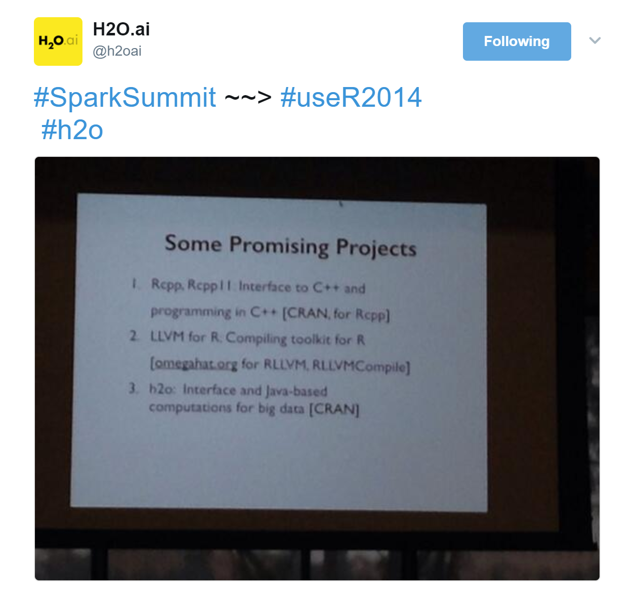
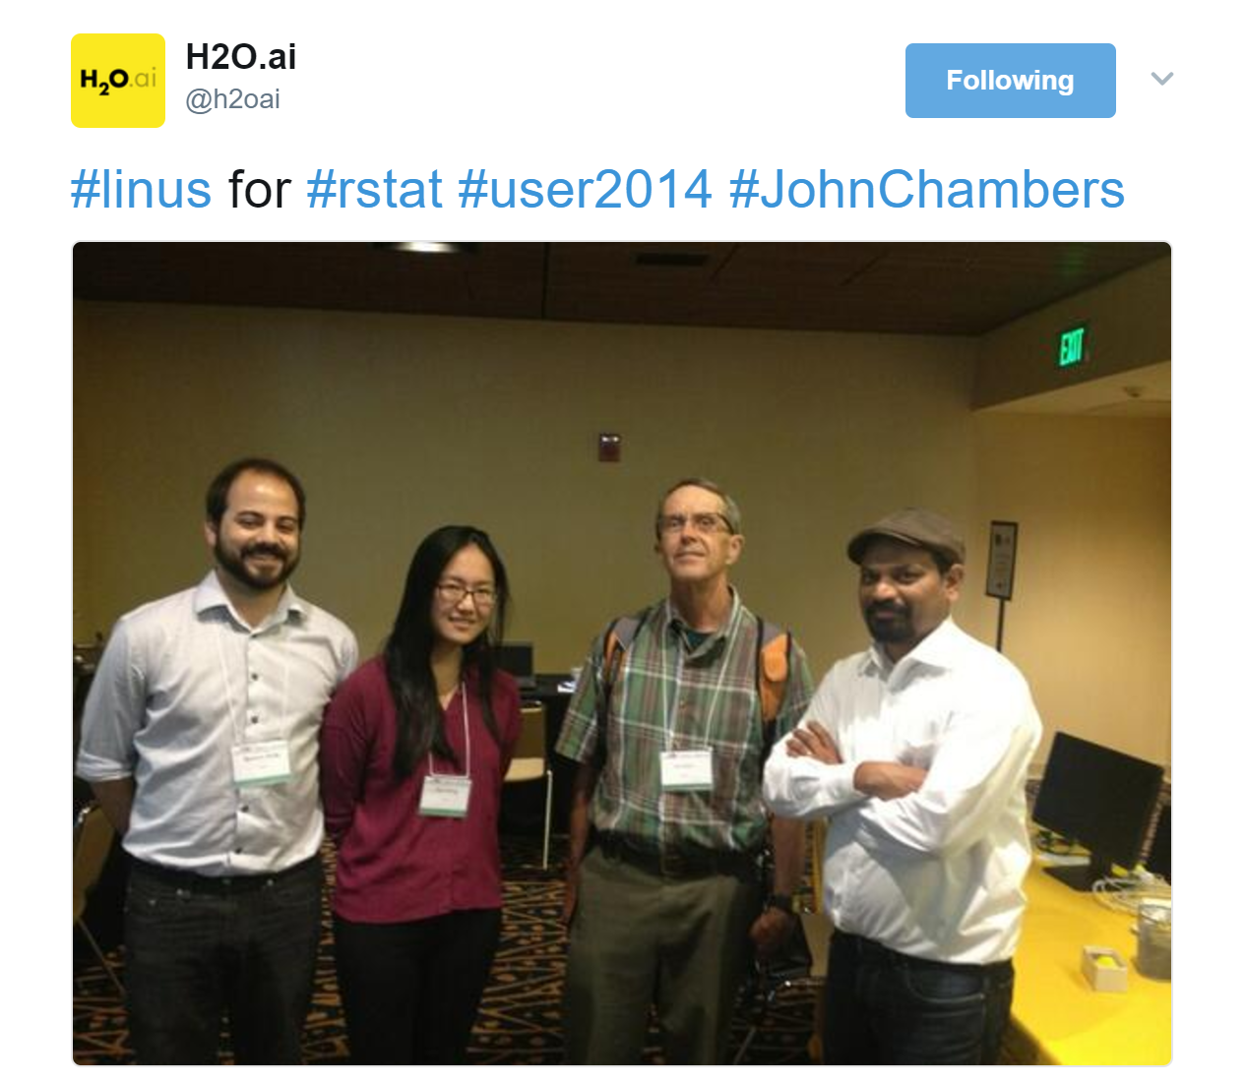
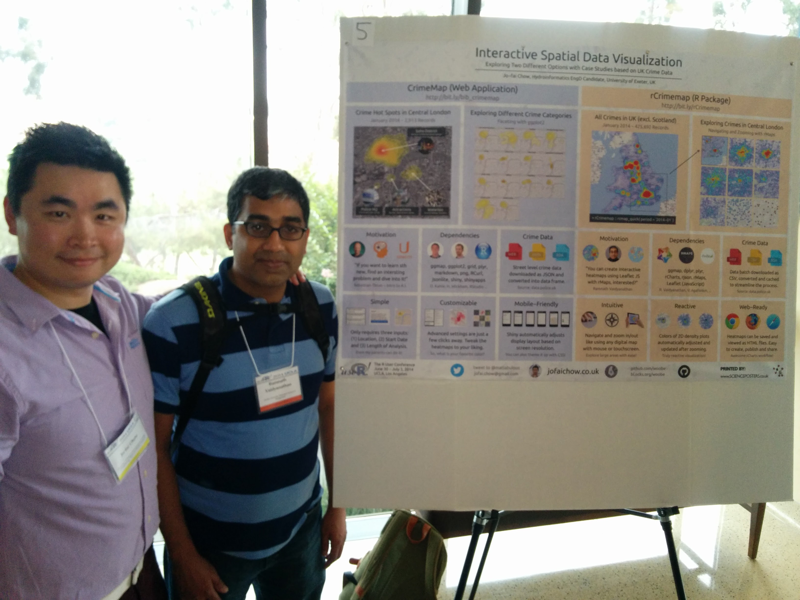
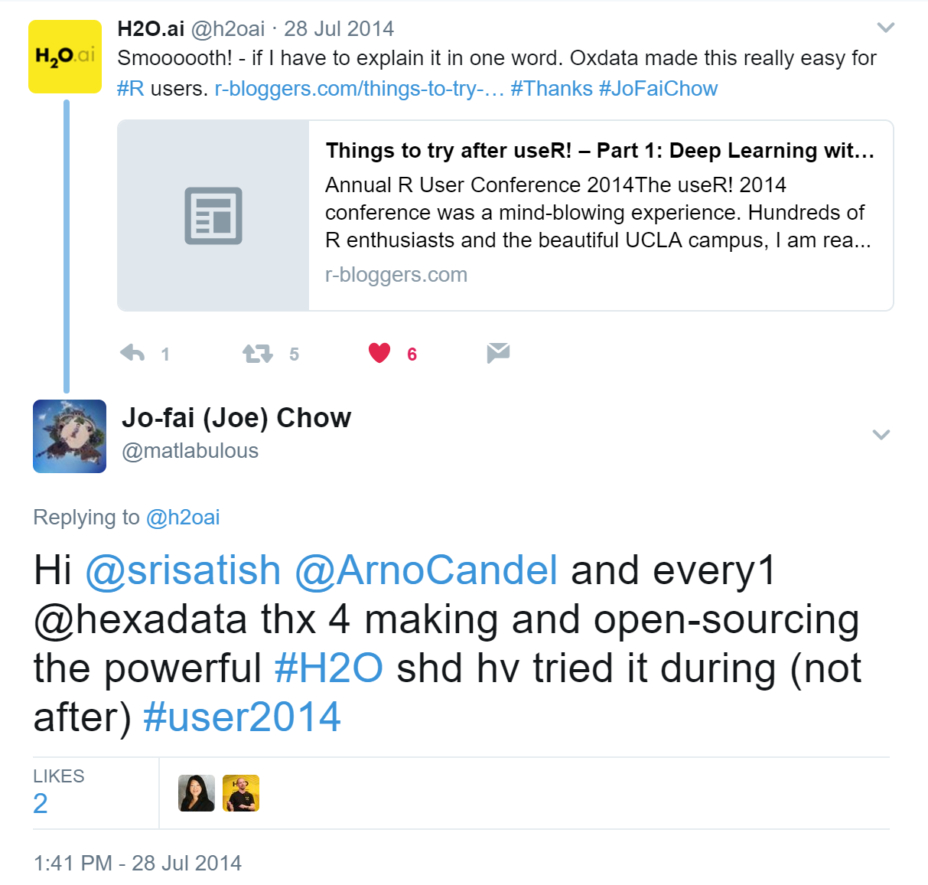
useR! 2014
CrimeMap -> poster
John Chambers mentioned H₂O
… so I gave it a try

Slide 6
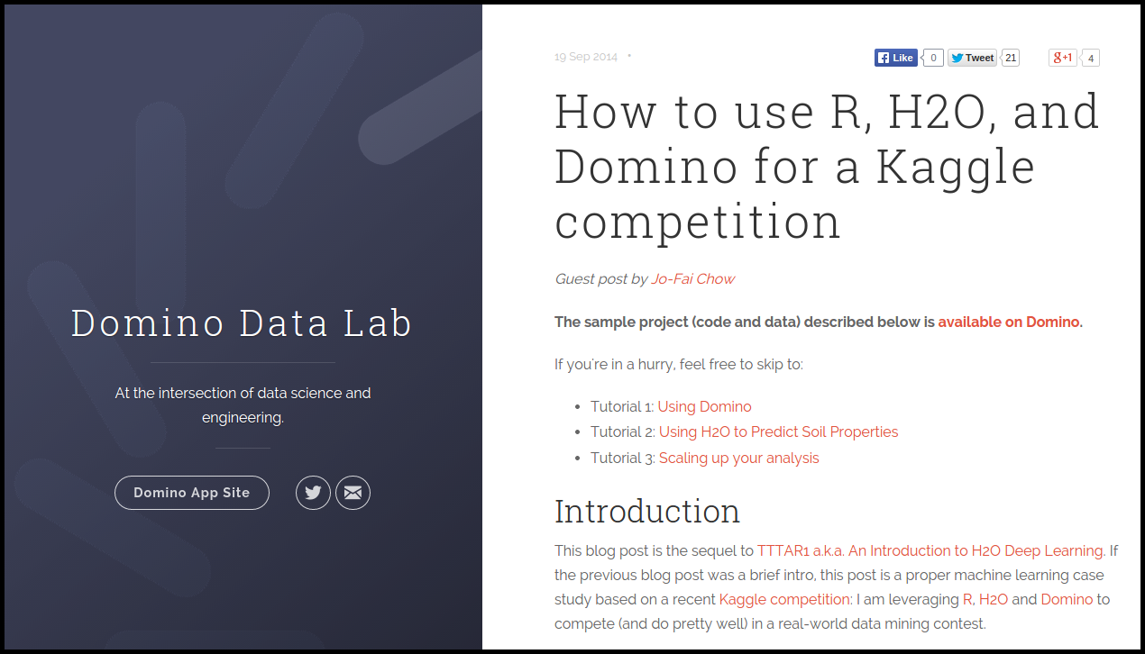
About Me – I ❤️ Kaggle
The Long Story
bit.ly/joe_kaggle_story
R + H₂O + Domino for Kaggle
Guest Blog Post for Domino & H₂O (2014)

Slide 7
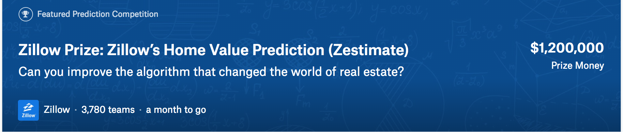
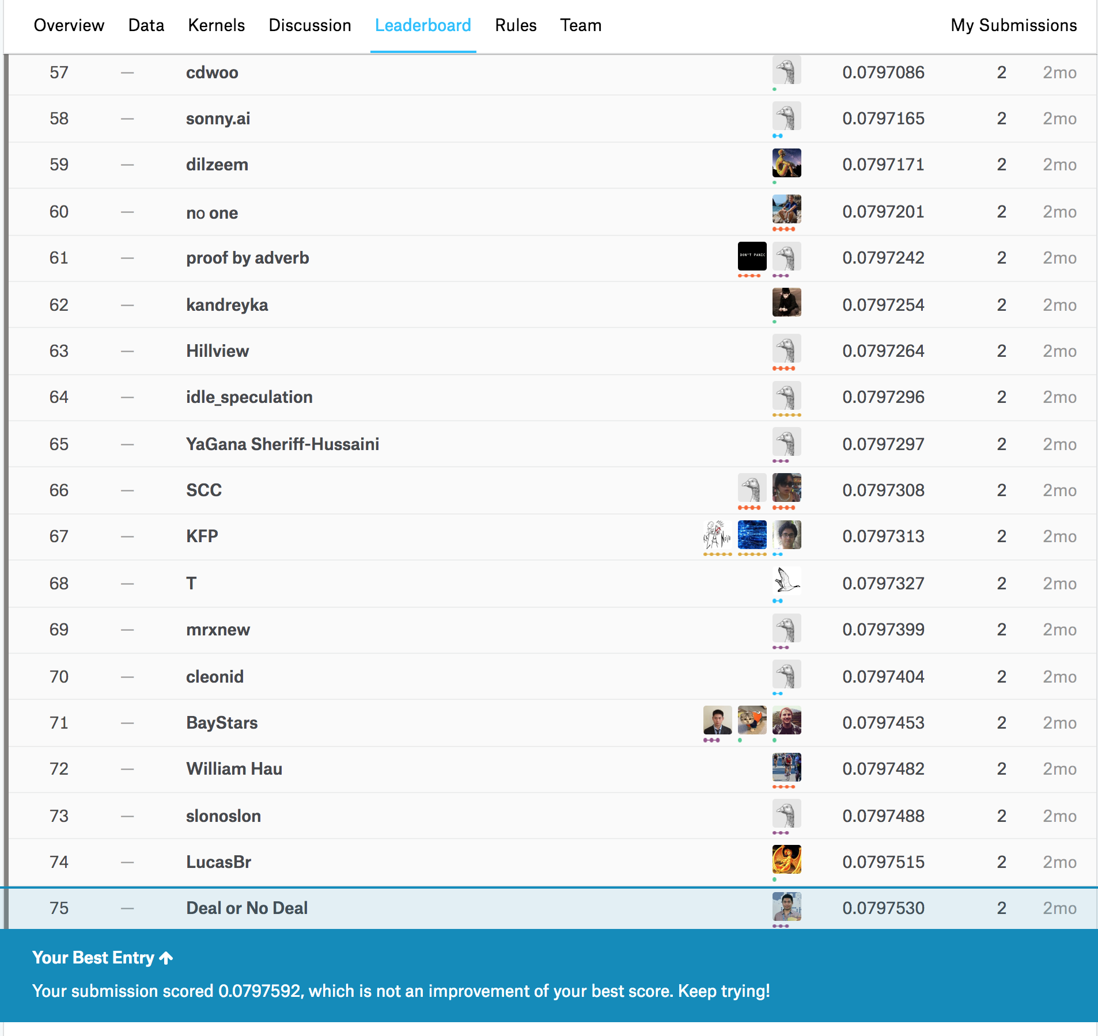
Marios Michailidis (KazAnova)
Mathias Müller (Faron)
Joe

